Slide 1
Tremors Analysis
Thampi, Jennie, Sarah, Robin, Meg

Slide 2
Dataset
We will be looking at earthquake data on a global scale for the past year (2019) to better understand where earthquakes occur most often on Earth. The earthquake data we pulled is from the USGS Earthquake Hazards Program site ( https://earthquake.usgs.gov).

Slide 3
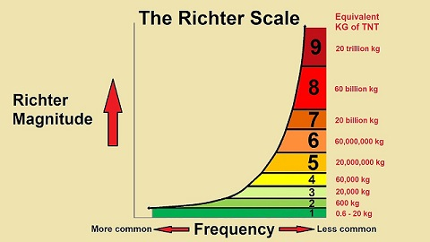
What is an Earthquake and how is it caused?
An earthquake is the result of a sudden release of stored energy in the Earth's crust that creates seismic waves. The term earthquake is used to describe any seismic event (natural or human-caused) that creates seismic waves.
In this project we will be referencing Earthquake Magnitude or Strength - this is in reference to the Richter magnitude scale
Logarithmic Scale - each integer increase represents a 10-fold increase in quake magnitude
Effects:
2.5 or less - usually not felt but are recorded
2.5-5.5 - felt, minor damage
5.5-6 - slight damage to buildings
6-6.9 - potential major damage in populated areas
7-7.9 - major earthquake with major damage
8+ - great earthquake that can totally destroy close communities
Source: https://www.youtube.com/watch?v=_q_2VdqiKbw
Notes:
A logarithmic scale that reflects the strength of an earthquake and the effect the quake may have
Each integer increase represents a 10-fold increase in quake magnitude

Slide 4
Questions & Hypothesis
After looking at the raw data we each came up with a question we would like to answer
Is there a certain time of year earthquakes occur more often or is there a difference between hemispheres?
Hypothesis: Earthquakes occur all year long, all over the earth.
Where are earthquakes most common?
Hypothesis: Most likely around the Ring of Fire.
Where are the biggest earthquakes occurring (& would you be able to feel them)?
Hypothesis: The biggest earthquake will be around the Ring of Fire.
Does earthquake depth have a correlation to strength?
Hypothesis: Shallow earthquakes are stronger (because they are closer)
How deep are most earthquakes and does location play a part in this?
Hypothesis: Most earthquakes are shallow and location does not play a part

Slide 5
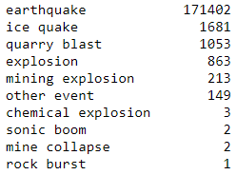
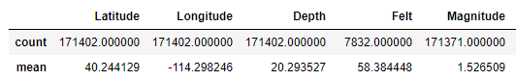
Data Cleanup & Exploration
Started by reading documentation and deciding to pull just one month of data to get data format
We found we had to pull by month due to request limits
Created lists for variables we wanted and used loops to pull and append data
Created master dataframe with everything
We noticed there were event types other than earthquakes so we filtered by type==earthquake only
Saved this new DF as our working csv file
.describe in Notebook for some quick stats
Problems and Tricky Tasks
Each chart needed different variables (so we all had to filter differently)
There were some NaN values that needed to be removed
We found some of the questions were easier to answer than others
General merge and request issues - fixed through trial and error

Slide 6
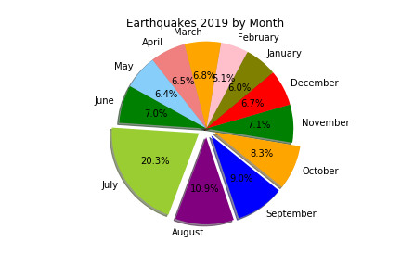
Is there a certain time of year earthquakes occur more often?
-In 2019 48% of all earthquakes occured within 4 months of the year July- October.
-20% of the total earthquakes in 2019 occured in July.
Due to time constraints we only pulled data for 2019 but in order to more accurately answer this question more analysis would need to be done with data spanning multiple years

Slide 7
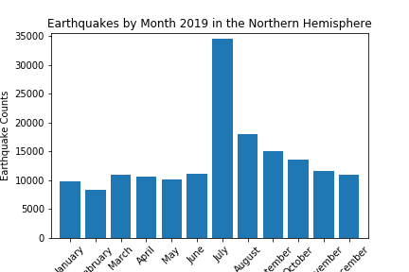
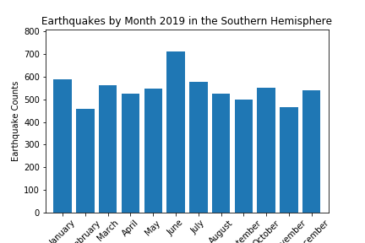
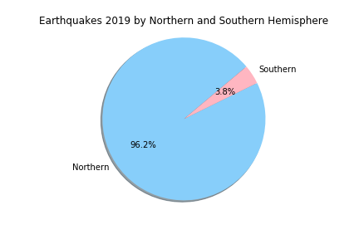
Does hemispheric location play a part in earthquake occurrence?
-While reviewing the data, we discovered that in July of 2019 there was an earthquake in California referred to as the 2019 Ridgecrest Earthquake Sequence- the amount of foreshocks and aftershocks created close to 7,000 records for the one event. This event alters the data for the Northern Hemisphere data- but is still significant to the total.
Notes:
We really need more than 1 year of data to determine if time of year is significant.
-In 2019 96% of all earthquakes occured in the Northern Hemisphere vs. 3.8% in the Southern Hemisphere.

Slide 8
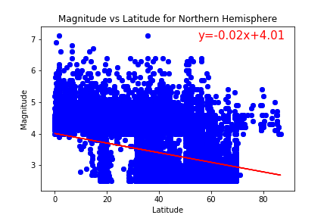
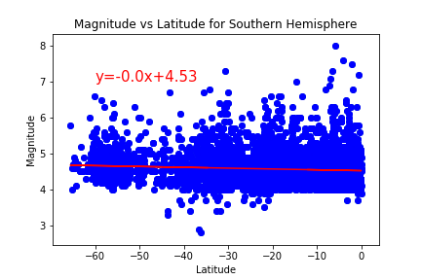
Where are the biggest earthquakes occurring (where would you be able to feel them)?

Slide 9
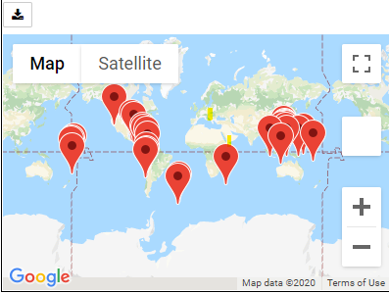
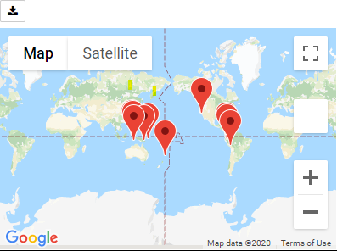
Where are the biggest earthquakes occurring (&where would you be able to feel them)?
Biggest quakes are around the Ring of Fire
Magnitude 6.5 and above
Magnitude 7.0 and above

Slide 10
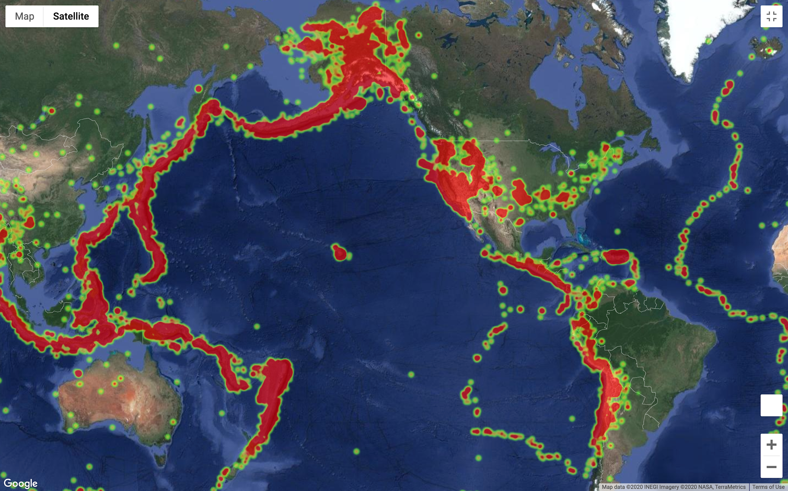
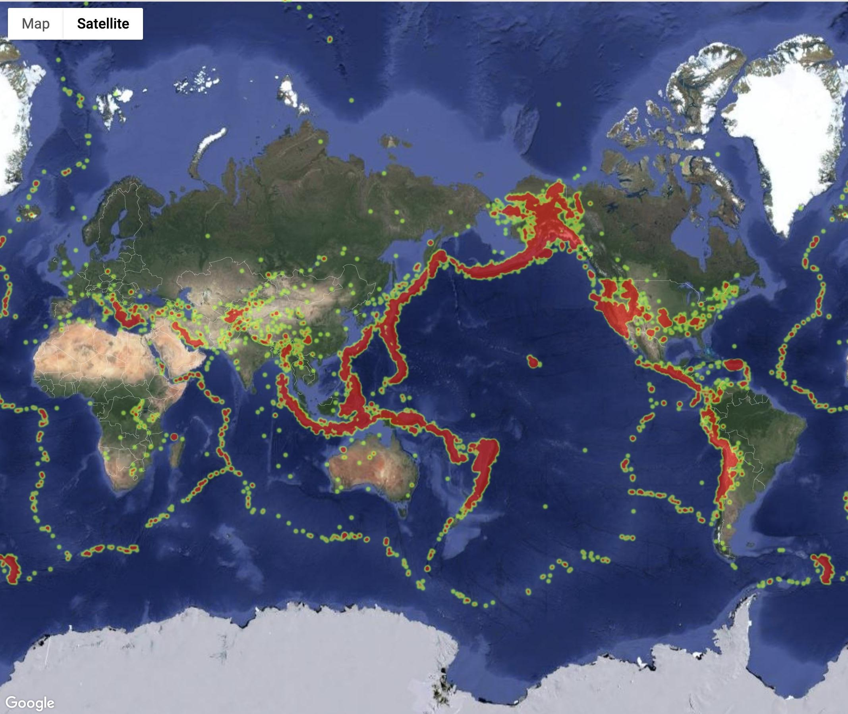
Where are earthquakes most common?
The Ring of Fire vs. All continents
Notes:
Sz - I would mention something about plate boundaries and fault lines being primarily where all the others are - can see the hawaii hot spot in the middle of the ring of fire too
Ocean stuffs -> plate boundaries - mid plate -> fault line stuff

Slide 11
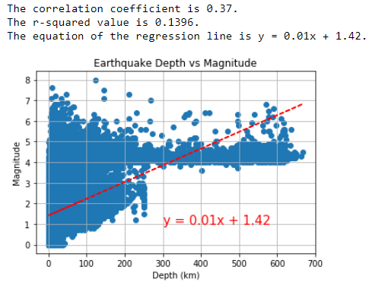
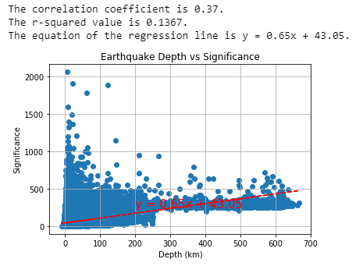
Does earthquake depth have a correlation to strength?
Doesn’t appear to be much of a relationship between these two variables
Shallow depths (<200km) seem to be able to produce any magnitude of earthquake
What about depth and significance?
Very similar values for correl coeff and r-squared
Shallow earthquakes do seem to be the most significant events

Slide 12
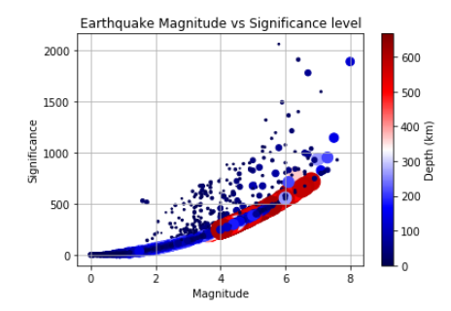
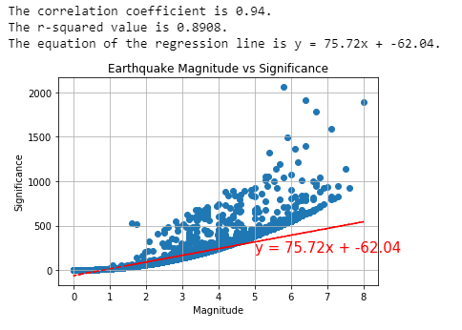
Does earthquake depth have a correlation to strength?
What about significance and magnitude?
High correlation coefficient and r-squared!
More like a non-linear correlation - Similar to Richter
Plot magnitude, significance and depth to see all variables

Slide 13
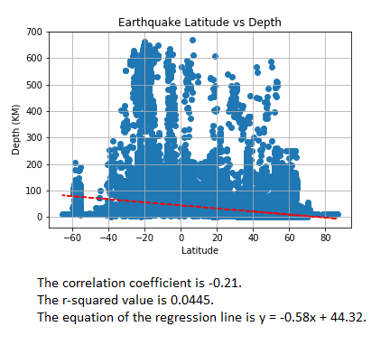
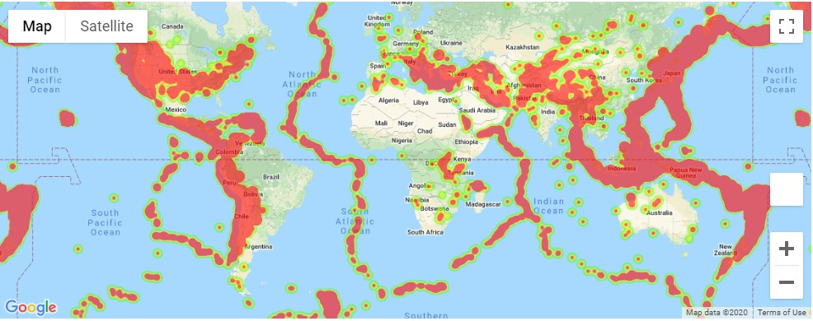
Does earthquake depth have a correlation to location?
There are some relationship between these two variables
Shallow depths (<200km) seem to be throughout the globe
Around the poles the earthquake depths are shallow and deeper around Ring of Fire

Slide 14
Discussion - Hypothesis findings
Is there a certain time of year earthquakes occur more often or a difference in hemispheric location?
Finding: 96% of all earthquakes in 2019 occured in the the Northern Hemisphere. 48% of all earthquakes occured within 4 months of the year, with 20% of all earthquakes in July. Need more than 1 year of data to make a more accurate conclusion.
Where are earthquakes most common?
Findings: They are most common around the Ring of Fire. Hypothesis correct.
Where are the biggest earthquakes occurring (& would you be able to feel them)?
Findings: The biggest earthquakes are around the Ring of Fire.
Does earthquake depth have a correlation to strength?
Findings: Not really but significance & magnitude do have correlation
It appears shallower earthquakes do tend to be most significant & can be any magnitude
How deep are most earthquakes and does location play a part in this?
Findings: Most earthquakes are shallow and location does play some part
The deepest earthquakes are also around the Ring of Fire and shallow ones around poles

Slide 15

Post Mortem
Difficulties
The way the data is configured on the USGS site
The data and time variables were reported together down to milliseconds and could not be separated or searched by indexing
Figuring out which plots were best to show for each of our question
General merge and request issues trying to combine final project - fixed through trial and error
Additional Questions this data brought up
There is a variable called alert which would be interesting to explore - which and where had the biggest alert status. Status relates to the economic impact the earthquakes had on the region.
A bigger data set over multiple years to answer our first question (Is time of year significant?) is needed
Creating more maps with the different variables to visualize which areas around the world are affected the most
Would be interesting to look more in depth at California and see the impact of earthquakes in one specific area

Slide 16
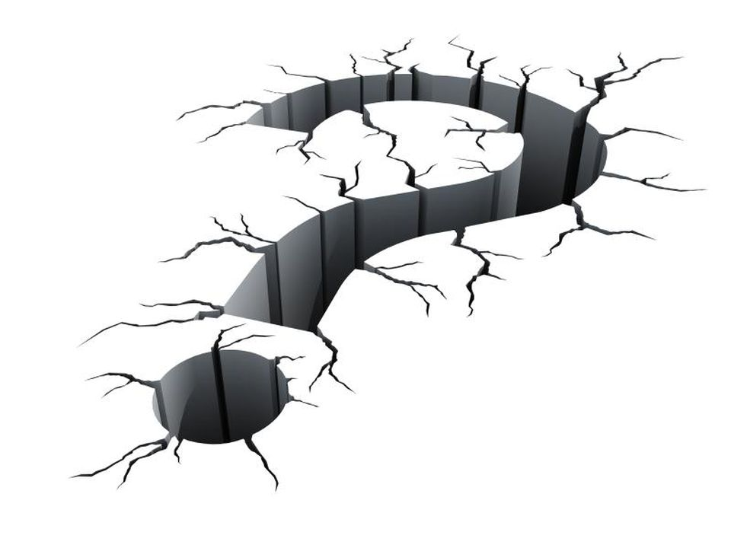
Any Questions???
Image Source: https://www.forbes.com/sites/sungardas/2014/10/27/how-the-loma-prieta-earthquake-pushed-me-into-the-disaster-recovery-business-and-others-out-of-business/#4c1209656c33

